Slide 1

Midterm Project:
Flight Delay Prediction
Olivia Han
&
Ripudaman Singh Bevli

Slide 2
01
Motivation
Objective:
Using departure and arrival information about flights in US in years 2018 and 2019.
Explore data and use the found relationships to perform Feature Engineering
Get familiar with supervised machine learning models
Predict flight delay for the first week of January, 2020

Slide 3
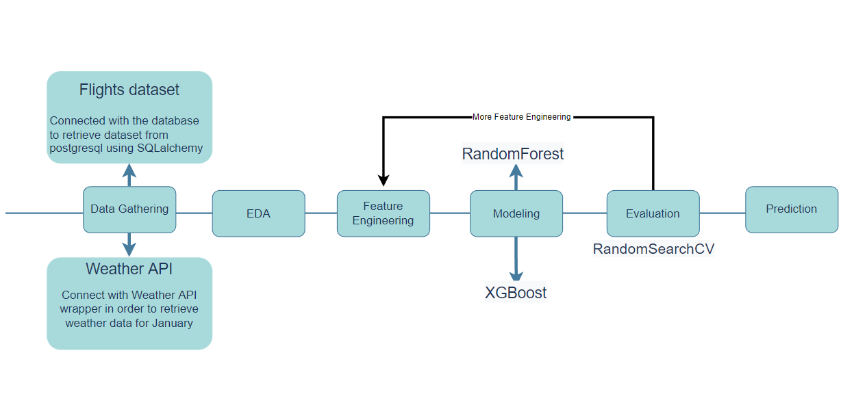
02
Project WorkFlow

Slide 4
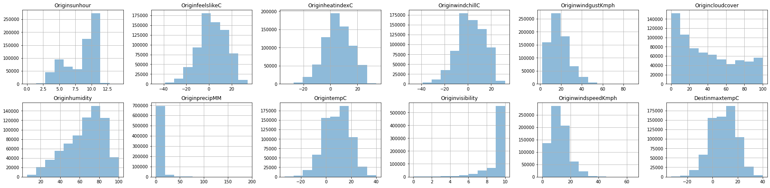
Weather API Feature Analysis

Slide 5
Weather API Feature Engineering
Clear
Cloudy
LightRain
Storm
Origincloudcover
'Weather_origin'
OriginprecipMM
‘Weather_origin' 'Weather_destin'
'Visibility_origin' 'Visibility_destin'
'windspeed_origin'
‘windspeed_destin'
LowVisibility
MediumVisbility
HighVisibility
Originvisibility
Visibility_origin
LowWindSpeed
HighWindSpeed
OriginwindgustKmph
windspeed_origin

Slide 6
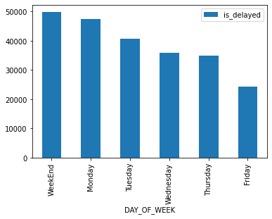
Which day of week is likely to have delayed flights?

Slide 7
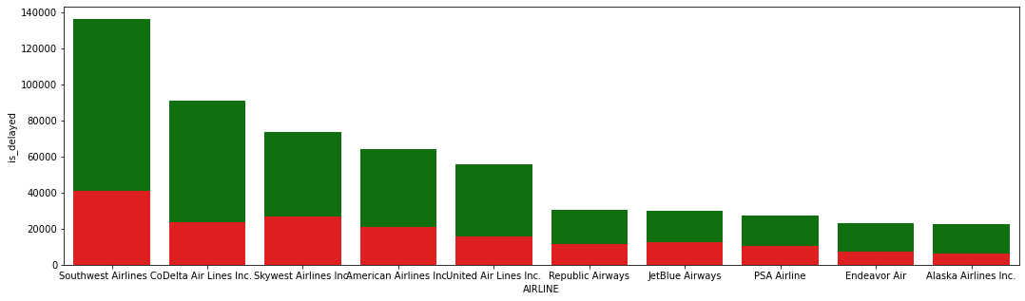
Airline Analysis: which airline is likely to delay?
Total No. of flights
No. of delayed flights
40.1% of JetBlue Airways are delayed among the top 10 busiest airline

Slide 8
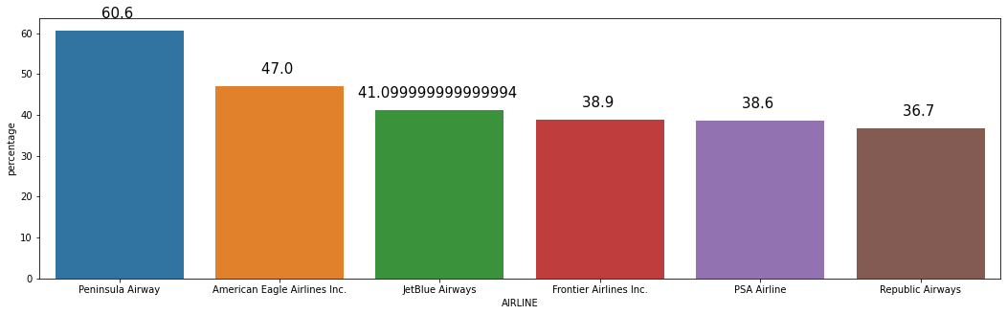
Airline Analysis: which airline is likely to delay?
41.1
Peninsula airway has 60% of delayed flights

Slide 9
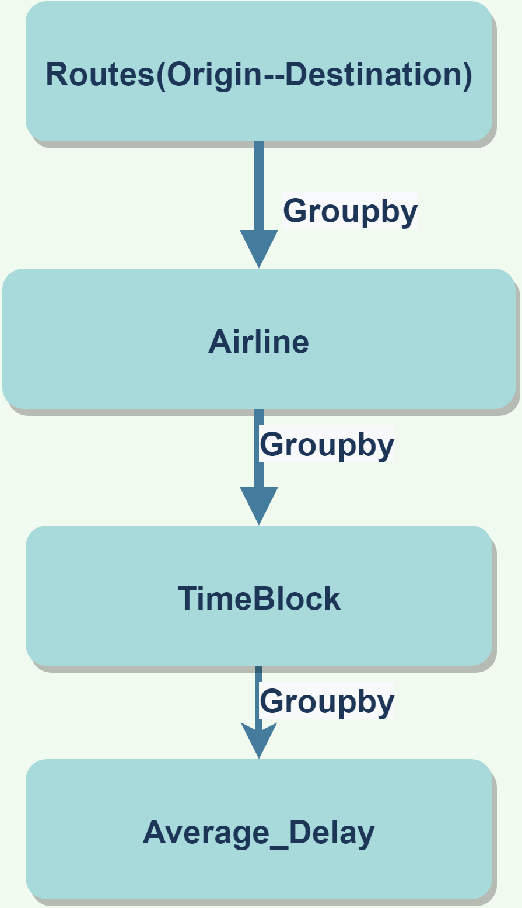
Feature Engineering:
Historical information about average delay
Departure and Destination airports pairs
Using unique carrier code
7:00-12:00
12:01-18:00
18:01-23:00
23:01-6:59
Calculate the average arrival delay

Slide 10
Modeling and evaluation
Random Forest Regression and XGboost Regression
Randomized Search cross validation for hyperparameters tuning
R^2 RFR : 0.199
R^2 after Validation: 0.21

Slide 11
Challenges and Future Recommendations
Challenges
Data Gathering
Feature Engineering
Recommendations
Multi classification: delay time range
Include more data

Slide 12
Thank you!

